Slide 1
KI23400 / KI27400 Series Loss Test Meter Training Manual
Revision: 8
Date: 14 Oct 2024

Slide 2
Table of Content (TOC)
General Features (Slide 3)
Instrument Overview & Layout (Slide 4)
Getting Started
➥ Select test cord configuration (Slide 5)
➥ Install / uninstall connector adaptor (Slide 6)
➥ Power
➥ External via USB (Slide 7)
➥ Batteries (Slide 8)
➥ Disable / enable battery charging (Slide 9)
➥ On / off instrument & LCD-backlight (Slide 10)
➥ To view firmware version & instrument serial number (Slide 11)
➥ To show all display segments of LCD (Slide 12)
Instrument Operation
➥ 2-way Autotest operation (Slides 13~20)
➥ 1-way Autotest operation (Slides 21~28)
➥ Restricted wavelength Autotest operation (Slides 29~31)
➥ Autotest User-to-User Communication operation (Slides 32~33)
➥ Light source manual operation (Slides 34~37)
➥ Power meter manual operation (Slides 38~46)
➥ ORL Meter (optional) manual operation (Slides 47)
➥ Tone detection operation (Slide 48)
➥ Slow Mode operation (Slide 49)
➥ Memory operation
➥ Store data into internal memory (Slide 50)
➥ Recall stored data from internal memory (Slides 51~58)
➥ Retest or overwrite results (Slides 59~60)
➥ Transfer internally stored data onto USB stick (Slide 62)
➥ Clear internal memory (Slide 63)
➥ Instrument Data Sanitization (Slide 64)
➥ Text ID Tag operation (Slides 65~70)
➥ Visible laser operation (Slide 71)
Instrument Settings
➥ Date & time (Slide 72)
➥ To deactivate beeping (Slide 73)
➥ To activate Slow Mode at instrument switch-on (Slide 74)
➥ Pass / fail thresholds setting (Slides 75~77)
➥ ORL UCAL (User CALibration) setting (Slides 78~79)
➥ ORL Zero Function (Slides 80~81)
➥ Reset ORL UCAL & NF (for Zero Function) to factory defaults (Slides 82)

Slide 3
General Features
Ease to use, slim & versatile
1-hookup bidirectional test (SM + MM) for Loss, length*, ORL*
Real time auto pass / fail
Larger, sunlight readable & backlit LCD
SM, MM (EF Compliant) & quad test options
Large memory & USB key file dump
Interchangeable connectors
Real-time, secure PC reporting software
* Only available on selected model
Continuity test tone with Multi-Fiber ID
VFL VisiTester* option
Long battery life, USB external power
>25 calibration λ, 1% accuracy
ISO 17025 traceable calibration
3 Year warranty & calibration cycle
Made in Australia
Return to TOC

Slide 4
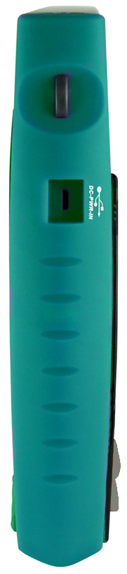
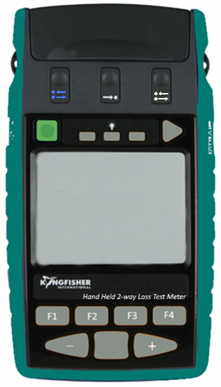
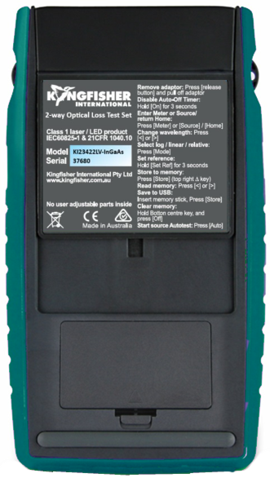
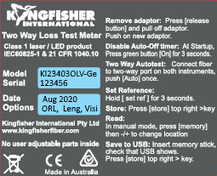
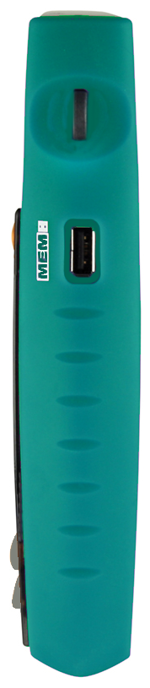
Instrument Overview & Layout
Connector release
(Power Meter port)
Connector release
(MM 2-way port)
Micro-USB of USB-C (for newer instrument version) port for external power
& computer interface
Connector release
(SM 2-way port)
Store/transfer memory
Connector Cover
Product label
Lanyard holder
Instrument model
LCD Backlight
Option included:
ORL, Leng (Length), Visi (VisiTester)
On/Off
Battery door
USB port for memory stick
LCD
Anti-slippery pad
Keypad
Return to TOC

Slide 5
Getting Started
➥ Select test cord configuration
Identify fibre type required for test cord and configuration required. Instrument supplied with SC connector adaptor as standard.
SC/SC-hybrid connector adaptor
Standard connector types:
XL connector types:
Note: Unlike light sources, power meters accept both PC and APC connectors.
Return to TOC

Slide 6

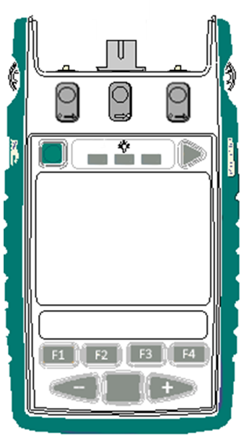
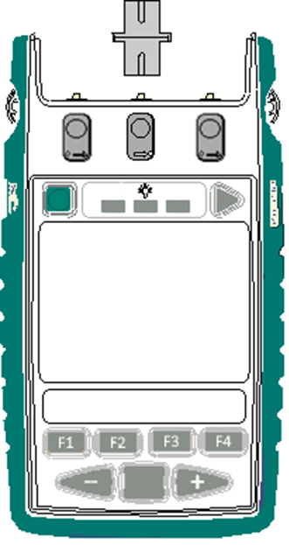

Getting Started
➥ Install / uninstall connector adaptor
The instrument comes with 2 or 3 ports (i.e., 1x or 2x 2-way port/s and 1x Power Meter port) depending on the models. See picture on the right for locations of these ports.
Install and uninstall connector adaptors to these ports as per steps below:
Power Meter port
❸
Adaptor slot on this side
SM 2-way port
❷
MM 2-way port
❶ Press down release button with finger of one hand.
❷ Pull out existing adaptor with the other hand.
❸ Push in a new adaptor.
❶
Return to TOC

Slide 7

Getting Started
➥ Power
➥ External via USB
Connect instrument to a computer or an external power pack via the micro-USB or USB-C (for newer instrument version) connector marked “DC-PWR-IN”.
Micro-USB or USB-C
Caution: When external source is connected, batteries in instrument will be charged if recharging is enabled.
To avoid recharging non-rechargeable batteries which may lead to acid leakage and instrument damage, make sure that recharging is disabled whenever these batteries are used.
See section, Disable/enable battery charging.
USB-A (to computer or power pack)
Return to TOC

Slide 8
Getting Started
➥ Power
➥ Batteries
To install / uninstall batteries:
➀ Unclip door of battery compartment at rear of instrument.
➁ Insert / remove batteries. Make sure that batteries are inserted in the correct polarities.
Battery compartment
Note:
Instrument’s date / time setting holds for approx. 2 minutes during batteries change over.
Use 2x Alkaline / Lithium AA cells or 2 x NiMH AA cells.
Alkaline battery run time up to approx. 1,000 hours.
Caution: Battery charging on instrument must first be disabled when using non-rechargeable batteries. See next page for instructions to disable battery charging.
Return to TOC

Slide 9
Getting Started
➥ Disable / enable battery charging
Insert the supplied programming-shunt across the pins inside battery compartment to disable or enable charging as shown below.
Battery charging disabled:
Supplied 0.1” pitch programming-shunt
programming-shunt is removed
Programming pins inside battery compartment
OR
Note: Instrument comes with the shut in this position.
Battery charging enabled:
Supplied 0.1” pitch programming-shunt
Return to TOC

Slide 10
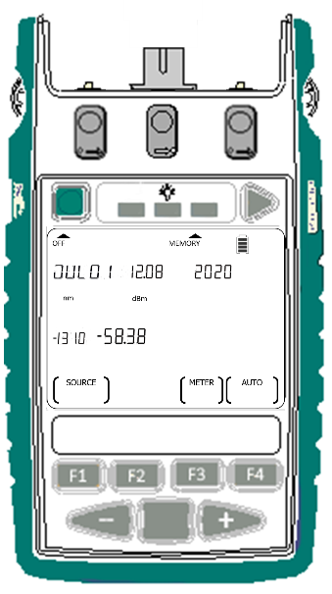

Getting Started
➥ On / off instrument & LCD-backlight
To switch on:
Press the green button.
To switch off:
Press the green again.
Battery charge indicator
Auto off feature:
When powered with batteries, instrument will switch off automatically 10 minutes after the last keypress.
To disable auto power off, press and hold green button for 3 seconds or until beeping stops. ‘Perm’ will display on the upper LHS of the LCD.
When powered via USB, auto off feature is automatically disabled.
Home display (Main menu)
“Month, Day”, “Time”, “Year”
(Upon powering up, instrument may require these to be entered e.g. after batteries are replaced.
LCD backlight: Press button below the light bulb symbol to turn backlight on or off.
Return to TOC

Slide 11
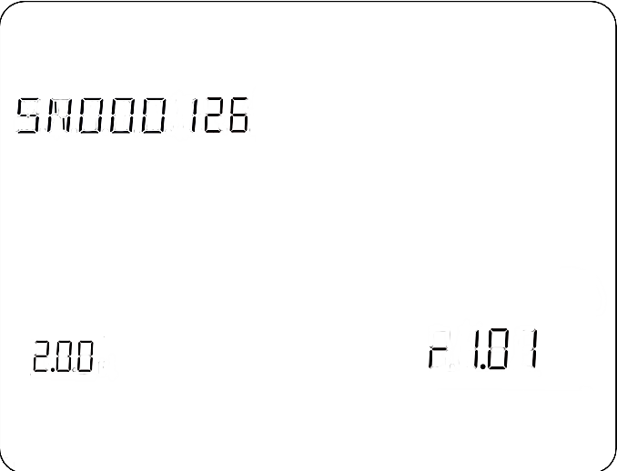
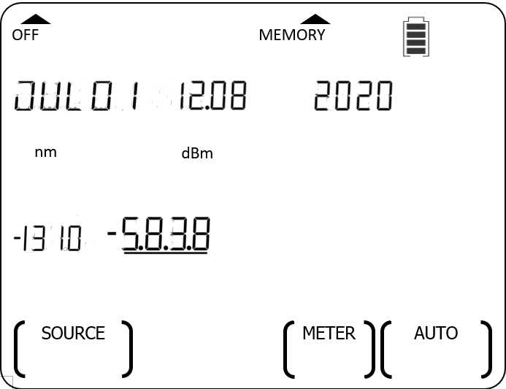

Getting Started
➥ To view firmware version & instrument serial number
➀ When instrument is off, hold down F4 then press green button.
➁ Continue to hold down F4.
➂ Release F4.
Instrument serial number
Home display is shown after button is released.
Hardware version
Firmware version
HOLD
HOLD
Return to TOC

Slide 12
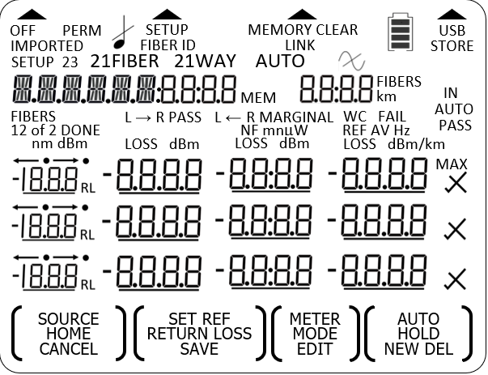
Getting Started
➥ To show all display segments of LCD
➀ When instrument is off, hold down F1 then press green button.
➁ Continue to hold down F1.
➂ Release F1.
Home display is shown after buttons are released.
Full segment display
HOLD
HOLD
Return to TOC

Slide 13

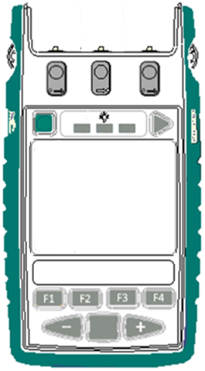
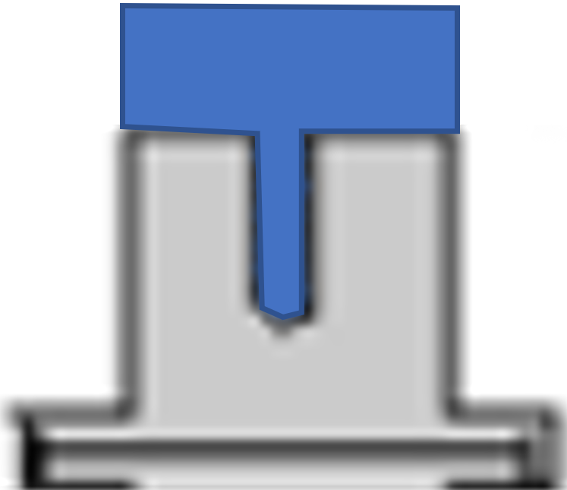
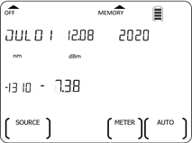
Instrument Operation
➥ 2-way Autotest operation
Work with a pair of instruments (same model) only
Performs bidirectional loss, ORL (optional), cable length (optional) measurements
Displays test result (pass/fail) automatically
Reference patch-lead
Adaptor on Power Meter Port covered with an opaque dust cap
SM
2-way port
Adaptor on Power Meter Port covered with an opaque dust cap
MM
2-way port
➀ Connect the 2-way ports of both instruments with a reference patch-lead.
IMPORTANT:
Light (especially fluorescent) entering the instruments via Power Meter ports may result in Autotest malfunctioning, so cover these ports on both instruments with opaque dust caps.
Continue next page
➁ Start Autotest:
Press F4 on any of the instruments.
Return to TOC

Slide 14
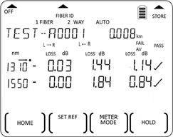
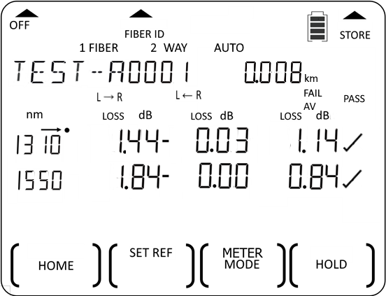
Instrument Operation
➥ 2-way Autotest operation (continue)
Reference patch-lead
Arrow sign indicating the data row which is being updated.
When Autotest starts, LCD of both instruments display losses of each direction and their respective averages for all active wavelengths.
For restricted wavelength Autotest, refer to slides 29~31.
Indicating instrument operating in 2-way Autotest mode
Flash to indicatesunit is operating in Autotest mode
Test data (bidirectional losses & their respective averages) and results,
for all active wavelengths are displayed here.
for each wavelength are shown in a row.
3 wavelengths can be shown simultaneously at a time. If more than 3 active wavelengths, screen auto scrolls & cycles to show all wavelengths
“Test Summary” display
“Test Summary” display
Continue next page
➂ Set reference: On any instrument, press down F2 until beeping stops.
Return to TOC

Slide 15
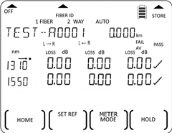
Instrument Operation
➥ 2-way Autotest operation (continue)
Reference patch-lead
When “SET REF” & “bUSY” stop blinking, values for cable length (optional), losses & average losses displayed on both instruments are zeroed momentarily.
Note:
The master unit (where Autotest was initiated) will be in Autotest standby mode if the fiber is disconnected from the 2-way ports for long enough. Autotest will resume automatically when a fiber is reconnected.
Allow approx. 10 seconds for the instruments’ displays to be updated with test data for a newly connected fiber.
“Test Summary” display
“Test Summary” display
Continue next page
➃ Reconnect instruments’ ports with DUT (Device Under Test) fiber.
Return to TOC

Slide 16
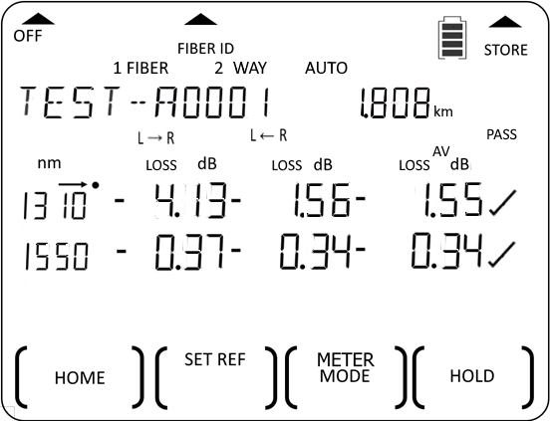
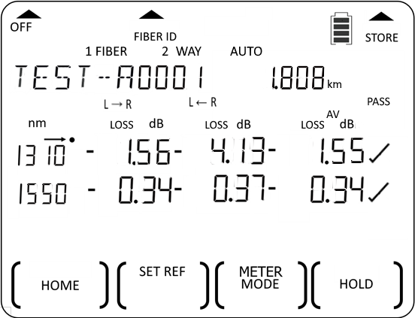
Instrument Operation
➥ 2-way Autotest operation (continue)
Cable length measured on Unit B:
Flashes (fail) if measured value is greater than set threshold.
Average loss (dB) of A►B & B►A @ 1310 nm
〰
〰
〰
〰
B►A loss (dBm) @ 1310 nm
Overall test result (“PASS” / “FAIL”):
“PASS”: if test result for loss of all wavelengths are “✓” or marginal (blinking “X”) and,, cable length (optional) test passes and, ORL (optional) test passes.
“FAIL”: if loss or ORL (optional) test result of any wavelength is “X” or, length (optional) test fails (blinking).
Note: For accurate pass/fail result on instrument model without Length and ORL options, set all thresholds for ORL and length to “0” (disabling them).
DUT fiber
A►B loss (dBm) @ 1310 nm
Cable length measured on Unit A:
Flashes (fail) if measured value is greater than set threshold.
Symbol signifying loss & ORLs(optional) pass/fail against the set thresholds (refer to Pass/fail Threshold Setting, slides 75~77) for a wavelength:
If AV (Average) method is selected:
“✓” : Pass/fail check is disabled (threshold value is set at “0”).
or
“✓” (pass): Average loss value (magnitude) is smaller than or equals to PASS threshold and, ORL (optional) passes.
Flashing “X” (marginal): Average loss value (magnitude) is greater than PASS but, smaller than or equals to MARGINAL thresholds and, ORL (optional) passes.
“X” (fail): Average loss value (magnitude) is greater than MARGINAL thresholds or, ORL (optional) fails.
If WC (Worst Case) method is selected:
“✓”: Pass/fail check is disabled (threshold value is set as “0”).
“✓” (pass): Worst case loss value (magnitude) is smaller than or equals to PASS threshold and, ORL (optional) passes.
Flashing “X” (marginal): Worst case loss value (magnitude) is greater than PASS but, smaller than or equals to MARGINAL thresholds and, ORL (optional) passes.
“X” (fail): Worst case loss value (magnitude) is greater than MARGINAL threshold or, ORL (optional) fails.
Note: For consistent pass/fail results, ensure the same thresholds are set on both instruments.
Average loss (dB) of B►A & A►B @ 1310 nm
A►B loss (dBm) @ 1310 nm
B►A loss (dBm) @ 1310 nm
“Test Summary” display
“Test Summary” display
Continue next page
Location-A
Location-B
➄ Display “Test Detail”: press F3 on one of the instruments.
Return to TOC

Slide 17
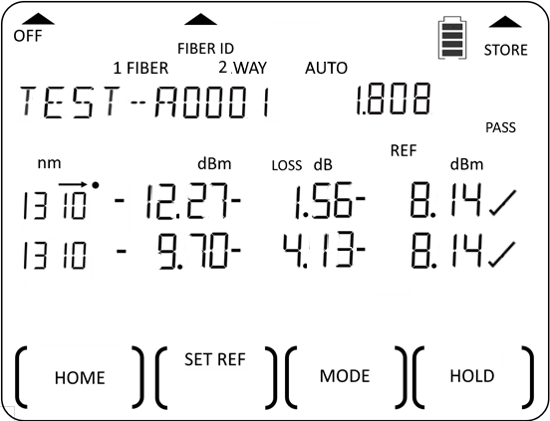
Instrument Operation
➥ 2-way Autotest operation (continue)
〰
〰
〰
〰
DUT fiber
A►B absolute power @ 1310 nm.
A►B loss @ 1310 nm.
A►B stored reference power @ 1310 nm.
Symbol signifying loss pass/fail against set threshold for a wavelength:
“✓” - Pass/fail check is disabled (threshold value is set as “0”).
or
“✓” (pass) - Loss values (magnitude) for both directions are smaller than or equal to PASS threshold.
Flashing “X” (marginal) - Loss value (magnitude) for either or both direction/s is/are greater than PASS but smaller than or equal to MARGINAL thresholds.
“X” (fail) - Loss value (magnitude) for one or both direction/s is/are greater than MARGINAL threshold.
km
“Test Summary” display
“Test Detail” display
B►A absolute power, loss, reference power @ 1310 nm.
Continue next page
At this display, press ‘+’ or ‘-” button to show loss data/result of other active wavelengths.
Location-A
Location-B
Return to TOC

Slide 18
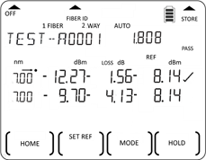
Instrument Operation
➥ 2-way Autotest operation (continue)
〰
〰
〰
〰
DUT fiber
Nominal power of Sources
km
Continue next pages,
to display ORL (optional) measurements & test result
To stop 2-way Autotest
“Test Summary” display
“Test Detail” display
➅ Display Source’s nominal power:
Hold down Toggle Centre.
LCD will return to previous display after button is released.
HOLD
Location-A
Location-B
Return to TOC

Slide 19



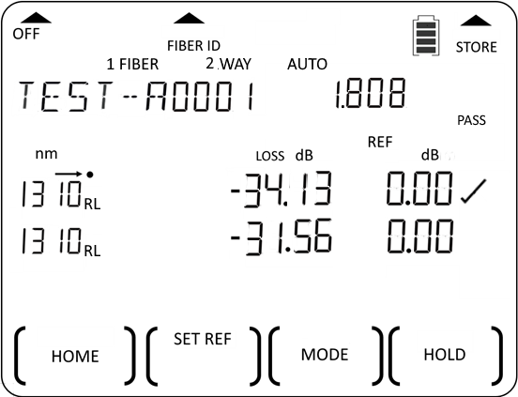
Instrument Operation
➥ 2-way Autotest operation (continue)
*NOTE:
For accurate ORL measurement on instruments with two 2-way ports, insert PC or APC Terminators as appropriate onto the unused ports to prevent stray light from entering the instrument.
DUT fiber
UCAL offset value for 1310 nm (see ORL UCAL Setting section)
〰
〰
〰
〰
B►A ORL value @ 1310 nm
Symbol signifying ORL pass/fail against set thresholds for a wavelength:
“✓” - Pass/fail check is disabled (threshold is set at “0.00”.
or
“✓” (pass) - ORL values (magnitude) for both directions are larger or equal to the set thresholds.
“X” (fail) - ORL value/s (magnitude) for one or both direction/s is/are smaller than the set thresholds.
DUT fiber
〰
〰
〰
〰
A►B ORL value @ 1310 nm
*
*
On this display,
press ‘+’ or ‘-” button to show ORL data/result of other active wavelengths.
Press F3 continuously to toggle between ORL Test, Test Summary, Test Detail displays.
“Test Summary” display
“Test Detail” display
km
“Test Summary” display
“ORL Test” display
Location-A
Location-B
➆ Enter ORL Test display:
Press F3.
Location-A
Location-B
Continue next page
Return to TOC

Slide 20
Instrument Operation
➥ 2-way Autotest operation (continue)
〰
〰
〰
〰
DUT fiber
Flashing indicates display stops updating.
Press F4 again resume display update.
“Test Summary” display
“ORL Test” display
➈
➈ Stop Autotest: Press down F1 until a beep is heard on any of the instruments.
➇ Stop/resume display update:
Press F4 repeatedly.
Location-A
Location-B
Return to TOC

Slide 21
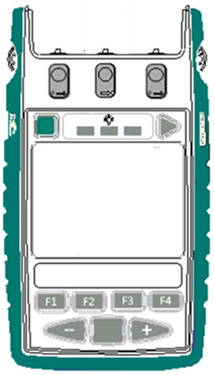
Instrument Operation
➥ 1-way Autotest operation
Performs 1-direction loss. Work with a single instrument or a pair of instruments.
Single Instrument
A pair of Instruments
➀ Connect ports on the same instrument with a reference patch-lead as shown below.
➀ Connect ports of the 2 instruments with a reference patch-lead as shown below.
Reference patch-lead
Reference patch-lead
Meter port
SM
2-way port
MM
2-way port
SM
2-way port
MM
2-way port
Meter port
Continue next page
Continue next page
Home display
Home display
Home display
➁ Start Autotest (on Source-unit): press F4.
➁ Start Autotest: press F4.
UNIT #1 (Source)
UNIT #2 (Meter)
Return to TOC

Slide 22
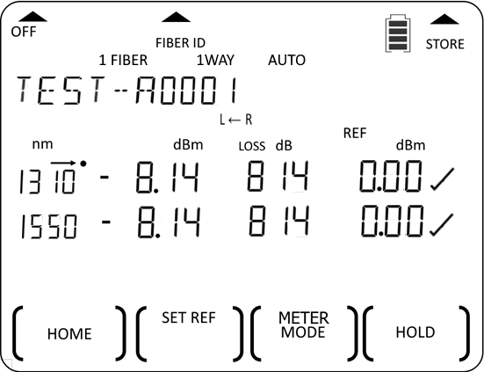
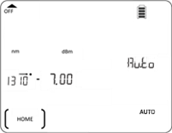
Instrument Operation
➥ 1-way Autotest operation (continue)
Reference patch-lead
Single Instrument
A pair of Instruments
Reference patch-lead
Arrow indicating data row which is being updated.
Cycle to display all active wavelengths
Indicating 1-way Autotest mode
Flashing “AUTO” indicating unit operating in Autotest mode
PASS
Test data and results,
for all the wavelengths received from source are displayed here.
for each wavelength are shown in a row.
for 3 wavelengths can be shown simultaneously at a time. If more than 3 wavelengths, screen will scrow and cycle to show all.
PASS
Continue next page
Continue next page
➂ Set reference: Press F2 on meter-unit until beeping stops.
➂ Set reference: Press F2 on meter-unit until beeping stops.
Return to TOC

Slide 23
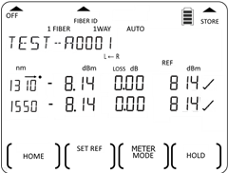
Instrument Operation
➥ 1-way Autotest operation (continue)
Single Instrument
Reference patch-lead
A pair of Instruments
Reference patch-lead
When “SET REF” & “bUSY” stop blinking:
Stored reference value is displayed here.
Loss value is zeroed momentarily.
PASS
Continue next page
PASS
Continue next page
➃ Reconnect ports with DUT fiber cable.
➃ Reconnect ports with DUT fiber cable.
Return to TOC

Slide 24
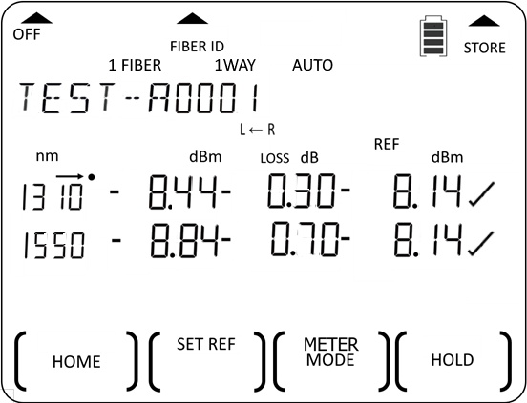
Instrument Operation
➥ 1-way Autotest operation (continue)
Single Instrument
A pair of Instruments
DUT fiber
〰
〰
〰
〰
DUT fiber
〰
〰
〰
〰
Absolute power (dBm)
Loss in dB
Overall test result:
“PASS”: if test results for all wavelengths are “✓” or marginal (blinking “X”.)
“FAIL”: if test result of 1 or more wavelength fails.
Reference power in dBm
Symbol signifying loss pass/fail against the set thresholds (refer Pass/fail Threshold Setting section) for each wavelength:
“✓” : Pass/fail check is disabled (threshold value is set as “0”).
or
“✓” (pass): loss value (magnitude) smaller than or equals to PASS threshold.
Flashing “X” (marginal): loss value (magnitude) greater than PASS threshold but smaller than or equals to MARGINAL threshold.
“X” (fail): loss value (magnitude) greater than MARGINAL threshold.
FAIL
FAIL
PASS
PASS
Continue next page
Continue next page
➄ Display absolute power in watt: Press F3 on meter-unit.
➄ Display absolute power in watt: Press F3 on meter-unit.
Return to TOC

Slide 25
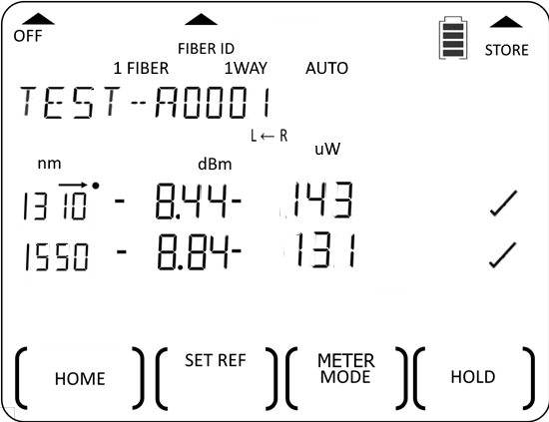
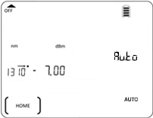
Instrument Operation
➥ 1-way Autotest operation (continue)
Single Instrument
A pair of Instruments
DUT fiber
〰
〰
〰
〰
DUT fiber
〰
〰
〰
〰
Absolute power in Watt
PASS
Continue next page
Continue next page
➅ Return display to show absolute power in dBm & loss in dB: Press F3 again.
➅ Return display to show absolute power in dBm & loss in dB: Press F3 again.
Return to TOC

Slide 26
Instrument Operation
➥ 1-way Autotest operation (continue)
Single Instrument
A pair of Instruments
DUT fiber
〰
〰
〰
〰
〰
〰
〰
〰
DUT fiber
Absolute power in dBm
Loss in dB
FAIL
PASS
PASS
Continue next page
Continue next page
Return to TOC

Slide 27
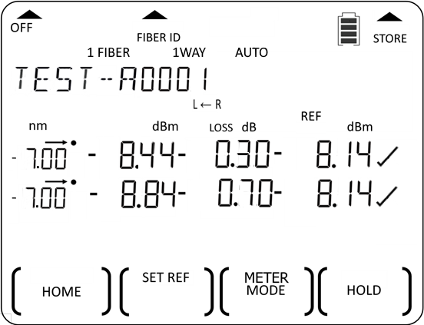
Instrument Operation
➥ 1-way Autotest operation (continue)
Single Instrument
A pair of Instruments
DUT fiber
〰
〰
〰
〰
DUT fiber
〰
〰
〰
〰
Source nominal power
PASS
PASS
Continue next page
Continue next page
➆ Display Source’s nominal power: Hold down Toggle Centre.
➆ Display Source’s nominal power: Hold down Toggle Centre.
HOLD
HOLD
Return to TOC

Slide 28
Instrument Operation
➥ 1-way Autotest operation (continue)
Note:
After the next fiber is connected during DUT change-over (without stopping Autotest), allow approx. 10 seconds for the instruments’ displays to be updated with data for that newly connected fiber.
Single Instrument
A pair of Instruments
DUT fiber
〰
〰
〰
〰
DUT fiber
〰
〰
〰
〰
Flashing “HOLD” indicates update has stopped.
PASS
PASS
➇ Stop / resume display update: Press F4 repeatedly.
➈ Stop Autotest: Press F1.
➇ Stop / resume display update: Press F4 repeatedly.
➈ Stop Autotest: Press F1 on Source-unit or disconnect the fiber for more than 8 seconds.
Return to TOC

Slide 29
Instrument Operation
➥ Restricted wavelength Autotest operation
There are two different ways (Method 1 & Method 2) to restrict the number of active λ for Autotest.
Method 1 (only applicable to instrument with 2x 2-way ports) :
a. To start λ-restricted Autotest: for SM port only (e.g., 1310-1550 nm on a Quad instrument):
At Home display, press ‘-’and F4 simultaneously.
b. To start λ-restricted Autotest: for MM port only (e.g., 850-1300 nm on a Quad-instrument) :
At Home display, press ‘+’ and F4 simultaneously.
SM
2-way port
MM,
2-way port
Return to TOC

Slide 30
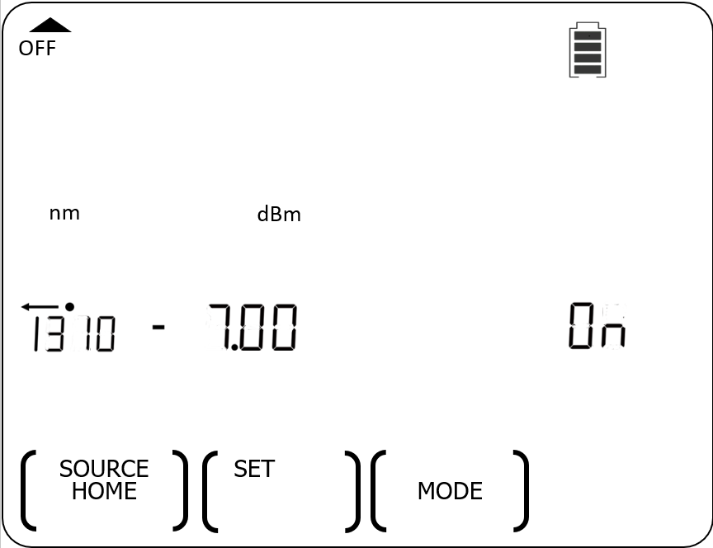
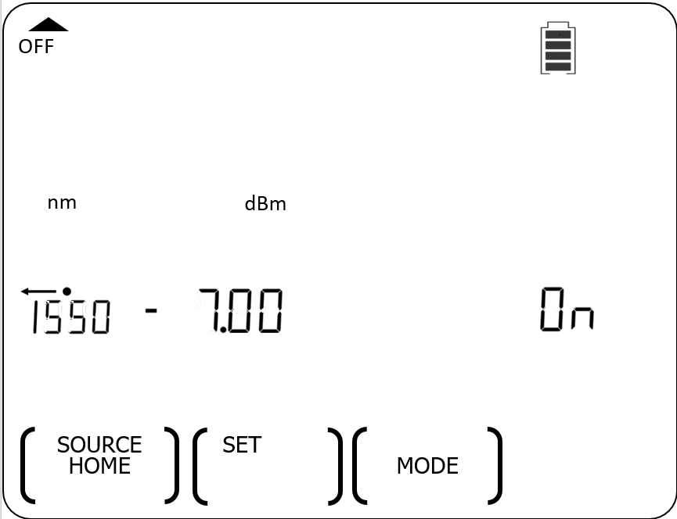
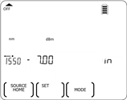
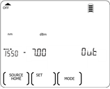
Instrument Operation
➥ Restricted-wavelength Autotest operation (continue)
Method 2:
➀ Excluding (deactivating) wavelength for Autotest:
➊ At Source mode, select the wavelength to be excluded/deactivated for Autotest e.g., 1550 nm: press ‘+’or ‘-”.
➋ View status of selected wavelength: hold down F4.
➌ “Deactivate” the selected wavelength: continue to hold down F4 then press Toggle Centre.
➍ Release F4.
1550 nm has been selected.
“in” indicating 1550 nm is currently activated (included for Autotest).
“Out” indicating 1550 nm is “deactivated” (excluded for Autotest).
Continue next page
HOLD
HOLD
HOLD
UNIT #1
UNIT #1
UNIT #1
UNIT #1
Return to TOC

Slide 31
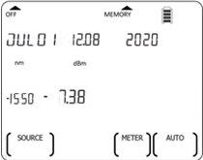
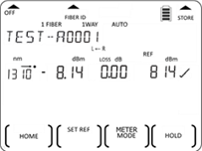
Instrument Operation
➥ Restricted-wavelength Autotest operation (continue)
Method 2 (continue):
➁ Start restricted-λ Autotest (with the selected wavelength excluded)
E.g., If the Source-instrument is a 2 wavelengths models with 1310-1550 nm sources, only “1310” displays here indicating that Autotest is running in restricted mode with only 1310 nm.
〰
〰
〰
〰
➎ Exit Source mode: press F1 Note: press Toggle Center to turn off Source prior to exiting.
➏ Start restricted-wavelength Autotest: press Toggle Centre and F4 simultaneously, on the unit which wavelength deactivation was performed.
E.g., In a 1-way Autotest operation, only test data and result for 1310 nm will be displayed. on Meter-instrument.
UNIT #1
UNIT #1
UNIT #1
UNIT #2
Return to TOC

Slide 32
Instrument Operation
➥ Autotest user-to-user communication operation
Apply to 2-way Autotest only.
➀ Near-end unit to signal Far-end unit during 2-way Autotest:
“HOLD” flashing & display update stops.
Unit beeps once and, “HOLD” flashing & display update stops.
Press F4
Near-end Instrument
Far-end Instrument
Near-end Instrument
Far-end Instrument
Return to TOC

Slide 33
Instrument Operation
➥ Autotest user-to-user communication operation (continue)
② Far-end unit to respond to Near-end unit during 2-way Autotest :
Unit beeps once and, “HOLD” stops flashing & display update resume.
“HOLD” stops flashing & display update resumes.
Press F4
Near-end Instrument
Far-end Instrument
Near-end Instrument
Far-end Instrument
Return to TOC

Slide 34
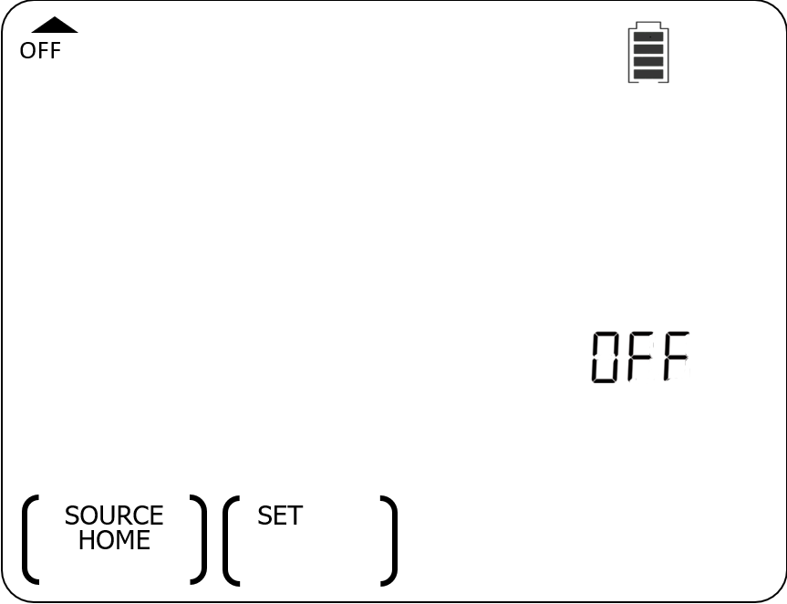
Instrument Operation
➥ Light source manual operation
Enter Source mode:
At Main menu (Home display), press F1.
a. Select wavelength or on/off output:
➊ Press ‘+’ or ‘-’ to cycle through & select an operating wavelength or, turn the output on/off off .
CW mode
➋ Press Toggle Centre will turn output on or off.
Available functions:
a. Select wavelength or on/off output
b. Adjust output power of selected wavelength
c. Select between CW (Continuous Wave) or Tone (modulation) output mode
d. Exit Source mode
Continue next page
Return to TOC

Slide 35
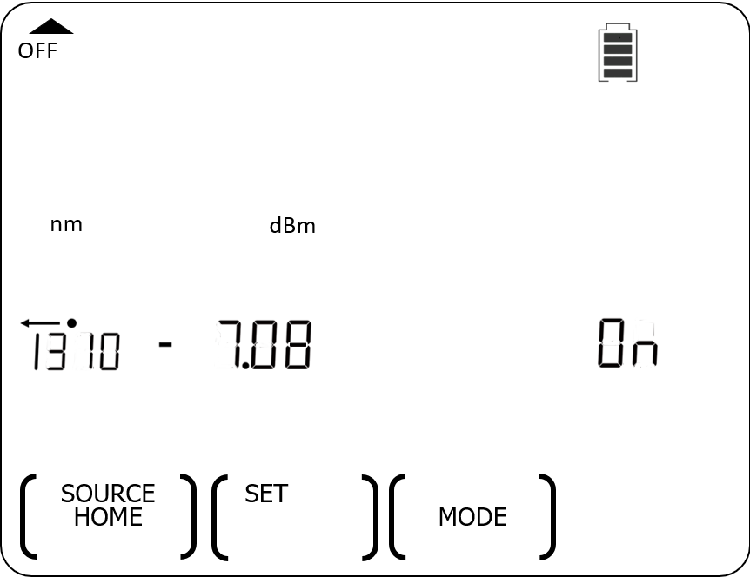
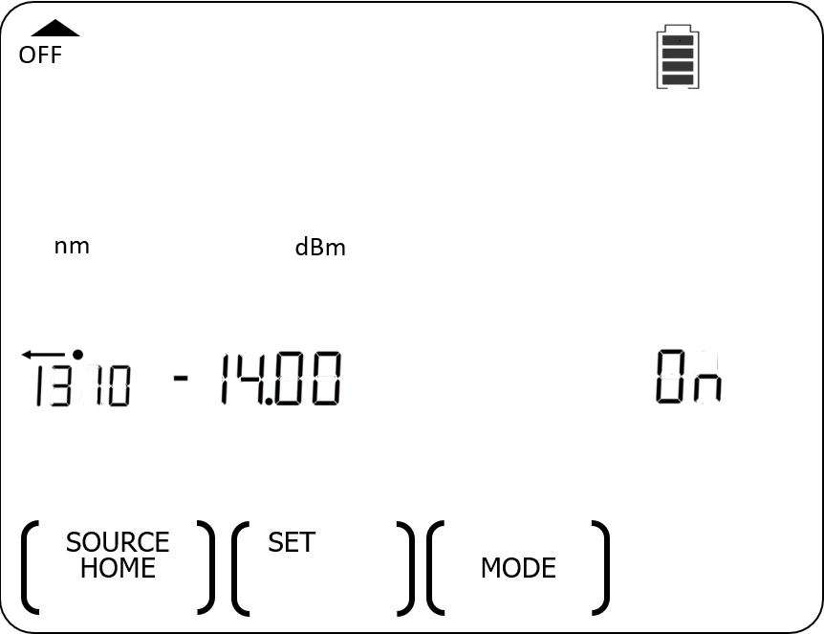
Instrument Operation
➥ Light source manual operation (continue)
b. Adjust output power of the selected wavelength:
- for laser source only
- output power can be adjusted in 0.01 dB steps for 7 dB.
➊ To adjust power level: hold down F2, then press ‘+’ or ‘-’.
Holding down ‘+’ or ‘-’ to speed up incremental or decremental of power levels.
➋ To toggle to max and min power levels: hold down F2 then, press Toggle Centre repeatedly.
Max power level
Min power level
Continue next page
HOLD
HOLD
HOLD
Return to TOC

Slide 36
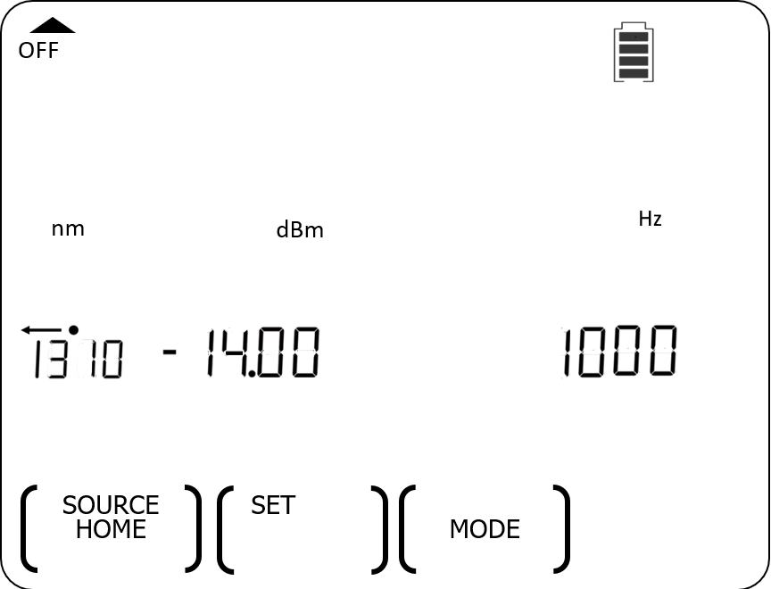
Instrument Operation
➥ Light source manual operation (continue)
C. Select between CW (Continuous Wave) or Tone (modulation) output mode:
Available test tones/id tones selectable in this sequence: On (CW), 270 Hz, 1000 Hz, 2000 Hz, id1 (300 Hz), id2 (400 Hz), id3 (500 Hz), id4 (600 Hz), id5 (700 Hz), id6 (800 Hz), id7 (900 Hz), id8 (1100 Hz), id9 (1200 Hz), id10 (1300 Hz), id11 (1400 Hz), id12 (1500 Hz).
To start test/Id tone mode:
At CW output mode, press F3 repeatedly to scroll through & select one from the available test/id tones.
Alternatively, hold down F3 and then press ‘+’ or ‘-’.
To end tone (modulation) output mode:
Hold down F3 for 3 seconds.
Alternatively, hold down F3 then, press Toggle Centre.
“Hz”
CW output mode
Tone output mode
CW output mode
Continue next page
HOLD
HOLD
HOLD
Return to TOC

Slide 37
Instrument Operation
➥ Light source manual operation (continue)
d. Exit Source mode:
Press F1 to exit Source mode & return to Home display (Main menu).
Note:
If the output is not turn off prior to exiting Source Mode, it will remain ‘on’.
To ensure that output is off after exiting Source mode, turn off output as per the instructions on slide 34, before F1 is pressed.
Return to TOC

Slide 38
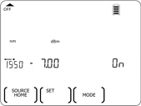
Instrument Operation
➥ Power meter manual operation
Measure power with a single instrument or a pair of instruments
Single Instrument
A pair of Instruments
➀ Connect ports on the same instrument with a reference patch-lead &,
select Source to output at CW mode at a wavelength (refer to Light Source Manual Operation section.)
➀ Connect ports of 2 instruments &,
select source-instrument to output at CW mode at a wavelength (refer to Light Source Manual Operation section.)
Reference patch-lead
Reference patch-lead
Reference patch-lead
Meter port
SM
2-way port
MM
2-way port
Meter port
SM
2-way port
MM
2-way port
E.g. 1550 nm is selected for output.
Source mode display
Source mode display
Home display
Continue next page
Continue next page
Home display
➁ Enter Meter mode:
Press F3
➁ Exit Source: mode: press F1.
➂ Enter Meter mode: press F3.
UNIT #1 (Source)
UNIT #2 (Meter)
Return to TOC

Slide 39
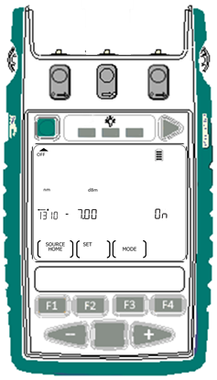
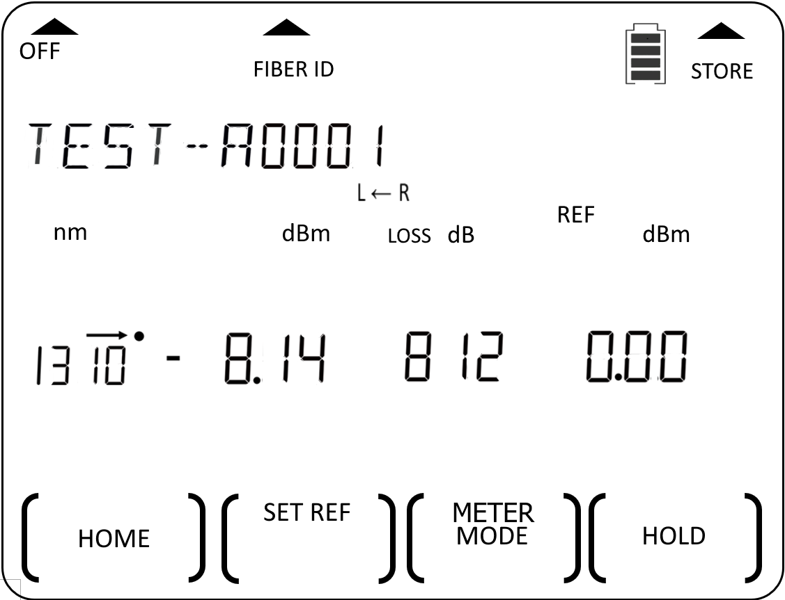
Instrument Operation
➥ Power meter manual operation (continue)
Single Instrument
A pair of Instruments
Reference patch-lead
Reference patch-lead
Text ID Tag (refer to Test ID Tag Operation Slides (61~66).
Wavelength (nm)
Absolute power (dBm)
Loss (dB)
Reference power (dB)
Continue next page
Meter mode display
Continue next page
➃ Select the matching λ of source: press ‘+’ or ‘-’.
➂ Select λ ( same as that on source): press ‘+’ or ‘-’.
UNIT #1 (Source)
UNIT #2 (Meter)
Return to TOC

Slide 40

Instrument Operation
➥ Power meter manual operation (continue)
Single Instrument
A pair of Instruments
Reference patch-lead
Reference patch-lead
E.g.: Wavelength 1550 nm is selected to math that of the Source.
Meter mode display
Continue next page
Continue next page
➄ Set reference: press and hold F2 until beeping stops.
➃ Set reference: press and hold F2 until beeping stops.
UNIT #1 (Source)
UNIT #2 (Meter)
Return to TOC

Slide 41
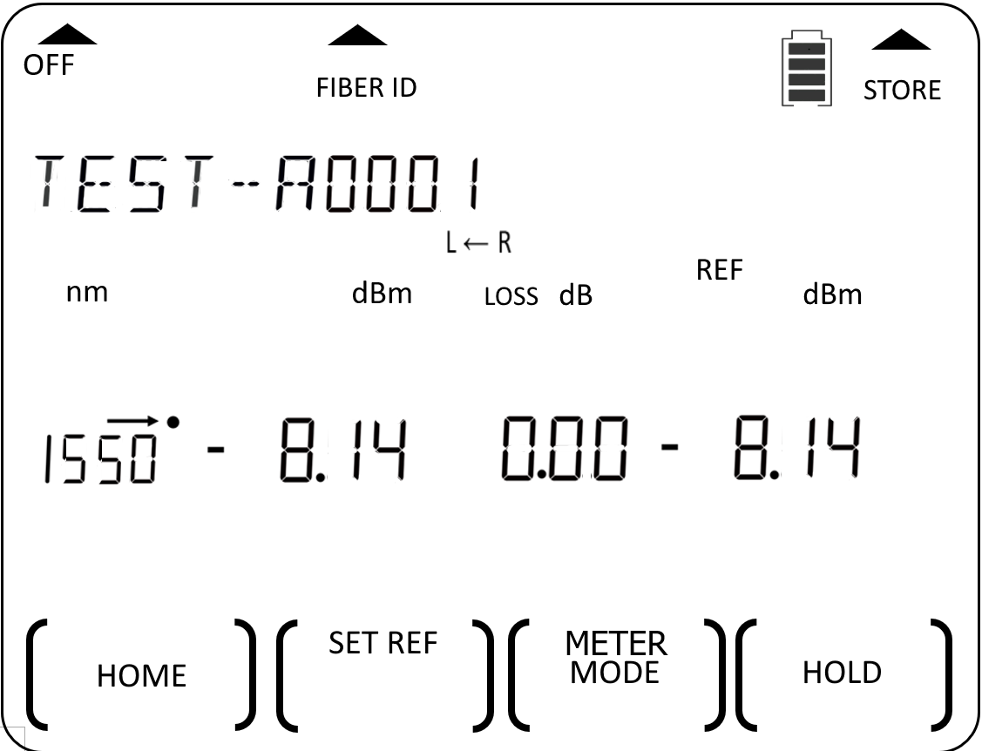
Instrument Operation
➥ Power meter manual operation (continue)
Single Instrument
A pair of Instruments
Reference patch-lead
Reference patch-lead
Loss value is zeroed.
Stored reference value displayed here.
Continue next page
Continue next page
➅ Display absolute power in watt:
press F3.
➄ Display absolute power in watt:
press F3.
UNIT #1 (Source)
UNIT #2 (Meter)
Return to TOC

Slide 42
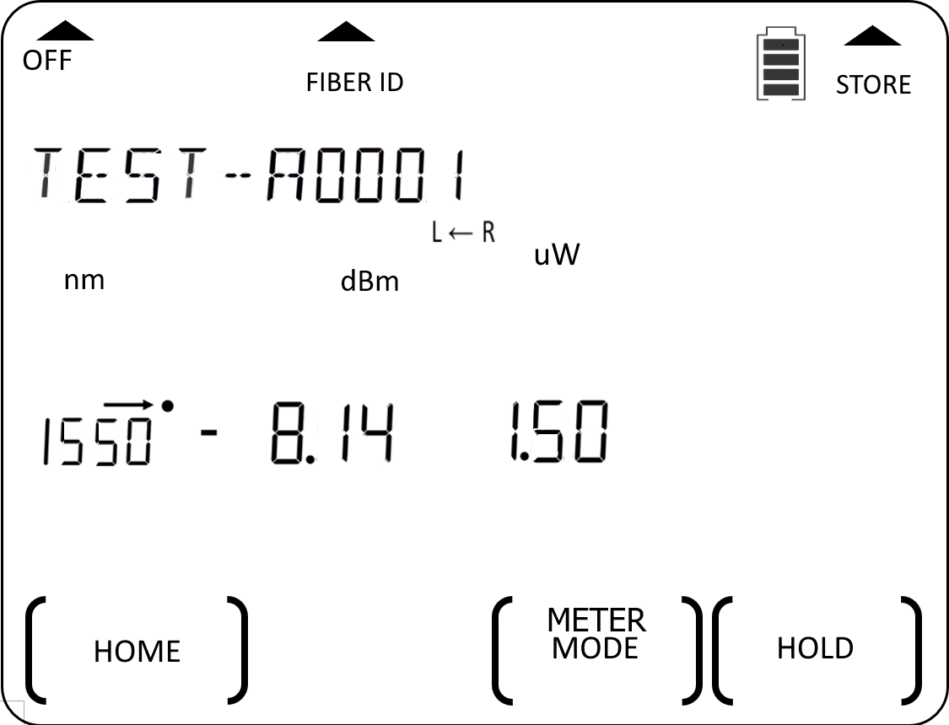
Instrument Operation
➥ Power meter manual operation (continue)
Single Instrument
A pair of Instruments
DUT fiber
〰
〰
〰
〰
DUT fiber
〰
〰
〰
〰
Absolute power (dBm).
Absolute power (Watt).
Continue next page
Continue next page
➆ Display min and max absolute power values in watt: press ‘+’ & ‘-’ simultaneously.
➅ Display min and max absolute power values in watt: press ‘+’ & ‘-’ simultaneously.
UNIT #1 (Source)
UNIT #2 (Meter)
Return to TOC

Slide 43
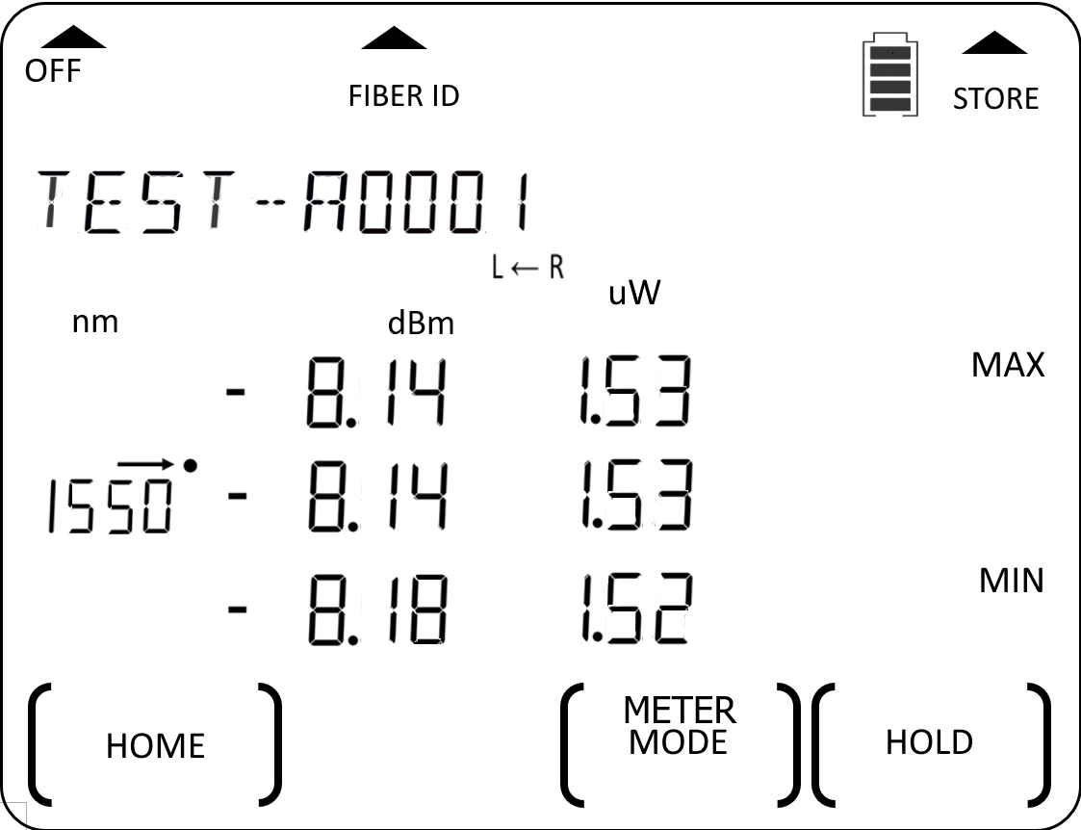
Instrument Operation
➥ Power meter manual operation (continue)
Single Instrument
A pair of Instruments
DUT fiberd
〰
〰
〰
〰
DUT fiber
〰
〰
〰
〰
Max absolute power in dBm & watt respectively
Min absolute power in dBm & watt respectively
Continue next page
Continue next page
➇ Display min and max absolute power & loss values in dBm & dB: press F3.
➆ Display min and max absolute power & loss values in dBm & dB: press F3.
UNIT #1 (Source)
UNIT #2 (Meter)
Return to TOC

Slide 44
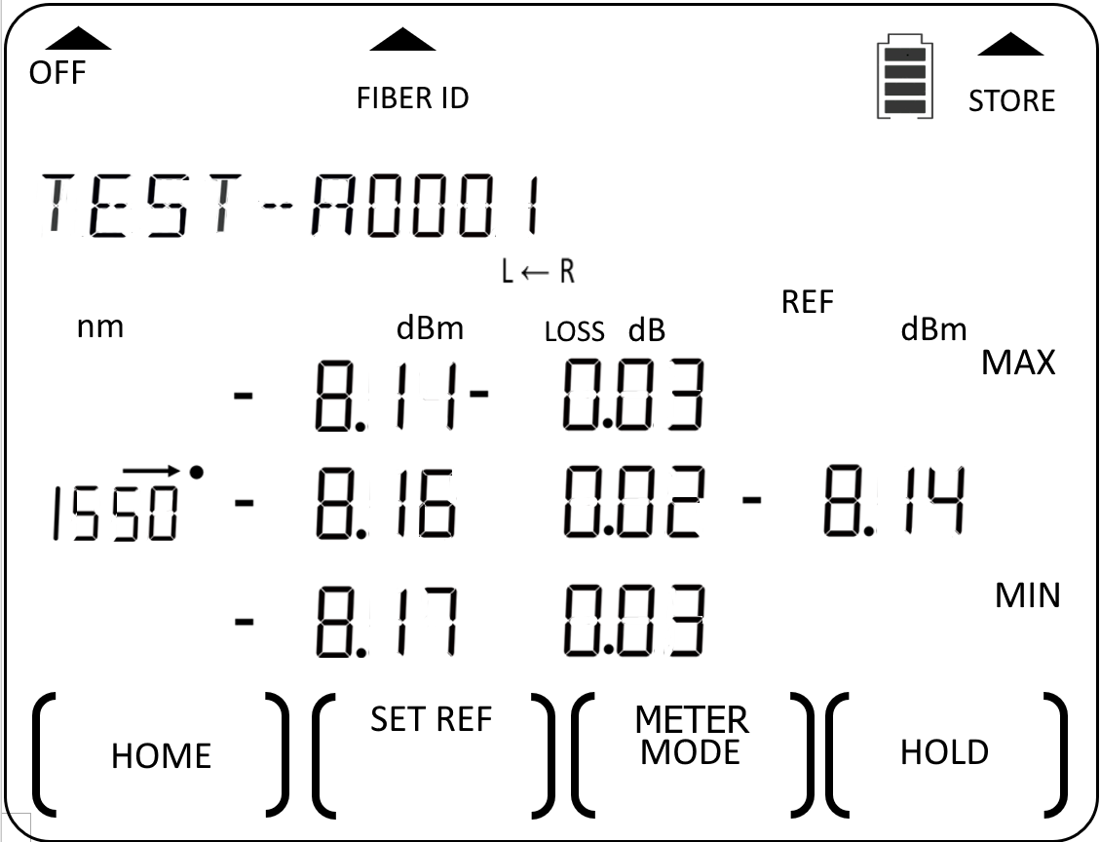
Instrument Operation
➥ Power meter manual operation (continue)
Single Instrument
A pair of Instruments
DUT fiber
〰
〰
〰
〰
DUT fiber
〰
〰
〰
〰
〰
〰
〰
〰
Max absolute power in dBm & watt respectively
Min absolute power in dBm & watt respectively
Continue next page
Continue next page
➈ To exit max/min values display:
Press ’+’ & ‘-’ simultaneously again.
➇ To exit max/min values display:
Press ’+’ & ‘-’ simultaneously again.
UNIT #1 (Source)
UNIT #2 (Meter)
Return to TOC

Slide 45
Instrument Operation
➥ Power meter manual operation (continue)
Single Instrument
A pair of Instruments
DUT patch-lead
〰
〰
〰
〰
DUT patch-lead
〰
〰
〰
〰
Continue next page
Continue next page
➉ To stop / resume display update:
press F4 repeatedly.
➈ To stop / start display update:
press F4.
UNIT #1 (Source)
UNIT #2 (Meter)
Return to TOC

Slide 46
Instrument Operation
➥ Power meter manual operation (continue)
Single Instrument
A pair of Instruments
DUT fiber
〰
〰
〰
〰
DUT fiber
〰
〰
〰
〰
“ HOLD” flashes indicating display update stops.
To resume display update, press F4 again.
⑪ To exit Meter mode: Press F1
(LCD will return to Home display).
➉ To exit Meter mode: Press F1
(LCD will return to Home display).
UNIT #1 (Source)
UNIT #2 (Meter)
Return to TOC

Slide 47

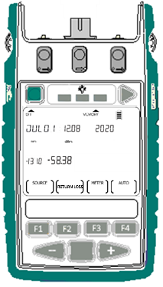
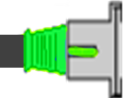
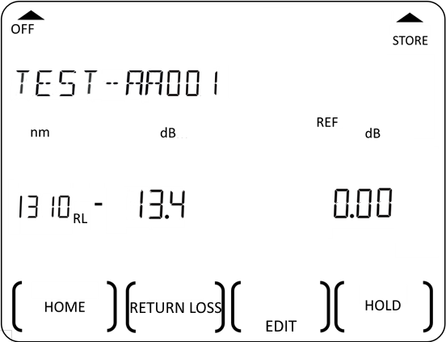

Instrument Operation
➥ ORL Meter (optional) manual operation
* NOTE:
For accurate ORL measurement on instruments with two 2-way ports, insert a PC or APC Terminators as appropriate onto the unused ports to prevent stray light from entering the instrument.
➀ Enter ORL measurement mode:
At Home Display , press F2
➁ Connect DUT onto the appropriate 2-way port
DUT
*
DUT
SM
port
MM
port
Measured ORL (dB) of DUT @ 1310 nm.
Press “+”or “-” to view ORL values of other active wavelengths.
UCAL offset (refer to slides 78, 79)
Home display
ORL mode display
ORL mode display
Home display
➂ Exit ORL measurement mode:
Press F1 to return to Home Display.
Return to TOC

Slide 48


Instrument Operation
➥ Tone detection operation
Tone detection starts automatically when,
Instrument’s Meter port is connected to Source port of the same or a different instrument.
&
The output of the Source port is a standard test tone or Id tone.
  &
Instrument is at Home display (Main menu) or in Meter mode.
This feature is useful for quick continuity/polarity checking of fibers.
Single Instrument
A pair of Instruments
Upon detecting a tone:
- the frequency and/or Id is displayed here.
- Instrument beeps to signify continuity.
Test or Id tone from another instrument
Upon detecting a tone:
- for standard test/Id tone: the frequency and/or Id is displayed here.
- for non-standard tone: the actual measured frequency in Hz is displayed here (150 ~ 9999 Hz.)
- Instrument beeps to signify continuity.
➟
Loopback
To stop tone detection:
Turn off Test/Id Tone mode of the Source (refer to Slide 36).
or
Turn on Slow Mode (refer to next slide).
Return to TOC

Slide 49


Instrument Operation
➥ Slow Mode operation
In Slow Mode:
Beeping stops.
Display show average optical power of the modulated signal, using a long average.
Test or Id tone from source port of the same (loopback) or another instrument.
➟
➟
➟
Selected wavelength,. Press + or – to select other active wavelengths.
Flashing symbol indicating Slow Mode is activated.
For single-unit operation (loopback):
When in Tone Detection mode, press F1 to go to this display.
The average power (dBm) of detected tone.
Press F3 to change to display tone power in nW.
➀ Enter Slow Mode:
press F4 to go into Slow Mode.
➁ To enter Meter menu:
Press F3
➂ To exit Slow Mode:
Press F3 and F4 simultaneously to return to Tone Detection mode.
Return to TOC

Slide 50



Instrument Operation
➥ Memory operation
➥ Store data into internal memory
Internal memory capacity:
8,000 fibers for one-way loss tests
4,000 fibers for two-way loss tests
E.g., Data in Meter mode is saved along with the Text ID Tag, “TSST-A0001” in memory location ‘8’.
The memory location-pointer and the Text ID Tag are incremented after each save operation. In this example, the next data will be saved along with Text ID Tag “TSST-A0002” in location ’9’ .
When instrument is operating in Meter or Autotest mode, press triangular button above “STORE” to save current measurement data in internal memory.
Note:
When data is being stored, the displays shows “bUSY” and will not respond to any keypress.
Text ID Tag
Once button is released, display will return to the last operation mode.
OR
Meter mode
Autotest mode
Return to TOC

Slide 51


Instrument Operation
➥ Memory operation
➥ Recall stored data from internal memory
The content of the last memory location stored with data will be recalled and displayed i.e., location ‘6’ in this example.
Press – or + to select the memory location to display data.
Location ‘1’ has been selected in this example.
At Home display (Main menu), press button above “MEMORY” to enter Memory mode.
Alternately displaying memory location & the Text ID Tag (if any) associated with the data.
Continue next page for viewing options for data saved in Meter mode.
Return to TOC

Slide 52

Instrument Operation
➥ Memory operation
➥ Recall stored data from internal memory (continue)
Viewing options for data saved in Meter mode:
Press F3 to toggle display to show absolute power in watt only or, in both dBm and watt.
Reference power in dBm
Absolute power in µW
Loss in dB
Absolute power in dBm
Absolute power in dBm
Wavelength in nm
Continue next page for viewing options for data saved in 1-way Autotest mode.
Return to TOC

Slide 53


Instrument Operation
➥ Memory operation
➥ Recall stored data from internal memory (continue)
Viewing options for data saved in 1-way Autotest mode:
Press F3 to toggle display to show absolute power in watt only or, in both dBm and watt.
Absolute power displayed in both ‘dBm’ & ‘watt’.
Absolute power in ‘dBm’.
Continue next page for viewing options for data saved in 2-way Autotest mode.
Return to TOC

Slide 54


Instrument Operation
➥ Memory operation
➥ Recall stored data from internal memory (continue)
Viewing options for data saved in 2-way Autotest mode:
Press F3 to toggle display to show between,
- Test summary (showing loss of each direction & their average by wavelength)
- Test detail (showing absolute power, loss, reference power for each direction by wavelength)
- ORL values (only for instrument models built with this option)
Loss value (dB) measured on remote unit @ 1310 nm
Measured cable length (Km)
Absolute power (dB) measured on local unit @ 1310 nm
Reference power (dB) of local unit @ 1310 nm
Loss (dB) value measured on local unit @ 1310 nm
Average loss (dB) @ 1310 nm
If ORL option is available, press F3 to view relevant data.
Loss value (dB) measured on local unit @ 1310 nm
Data @ 1550 nm
Test direction: remote-to-local
Symbol signifying loss test results (refer to Slide 17)
Symbol signifying loss test results (refer to Slide 16)
Test Summary Display
Test Detail Display
Test Detail Display
Test direction & data for local-to-remote unit.
Press F4 continuously to show data of all active wavelengths.
Return to TOC

Slide 55

Instrument Operation
➥ Memory operation
➥ Recall stored data from internal memory (continue)
Viewing options for data saved in 2-way Autotest mode: ORL data
UCAL offset values for 1550 nm set on local unit (refer to slides 77, 78)
ORL value (dB) measured on local unit @ 1550 nm
UCAL offset values for 1550 nm set on remote unit (refer to slides 77, 78)
Continue from last slide
ORL value (dB) measured on remote unit @ 1550 nm
Symbol signifying ORL test result for a wavelength:
“✓” - Pass/fail check is disabled (threshold is set at “0.00”)
or
“✓” (pass) – passed ORL test
“X” (fail) – failed ORL test fails.
2-way Autotest ORL data display
Return to TOC

Slide 56

Instrument Operation
➥ Memory operation
➥ Recall stored data from internal memory (continue)
Viewing ORL data saved in manual ORL mode:
UCAL offset values for 1550 nm set (refer to slides 77, 78)
ORL value (dB) measured @ 1550 nm
Manual ORL data display
Return to TOC

Slide 57

Instrument Operation
➥ Memory operation
➥ Recall stored data from internal memory (continue)
Viewing time stamp of saved data:
While viewing data saved in any of the 3 modes (Meter, 1-way Autotest, 2-way Autotest), hold down Toggle Centre.
OR
OR
Continue next page for viewing nominal source power.
Data saved in Meter mode
Data saved in 1-way Autotest mode
Data saved in 2-way Autotest mode
HOLD
HOLD
HOLD
HOLD
Release Toggle Centre now will return to the previous memory viewing display.
Return to TOC

Slide 58


Instrument Operation
➥ Memory operation
➥ Recall stored data from internal memory (continue)
Viewing nominal source power:
While viewing data saved in 1-way Autotest or 2-way Autotest, hold down the left most rectangular button (above LCD).
Data saved in 1-way Autotest mode
Data saved in 2-way Autotest mode
To Exit Memory mode:
Press F1 and return to Home display (Main menu).
HOLD
HOLD
HOLD
HOLD
Test Summary Display
Test Detail Display
Press F3 to show result in Test Detail Display.
Return to TOC

Slide 59

Instrument Operation
➥ Memory operation
➥ Retest or overwrite results
➊ Note current memory location
➋ Go to memory location to retest (overwrite data)
➀ Enter Memory mode:
At Home display (Main menu), press button above “MEMORY” to enter memory mode.
➁ Note currently displayed memory location:
E.g., the current location is ‘6’ is to be noted.
➂ Select memory location to overwrite data:
Press ‘–’ to go the location, then hold down button above “MEMORY” and press F2 for three seconds or until it stops beeping.
E.g., Memory location ‘3’ has been selected for retest (data overwriting).
HOLD
Continue next page
Return to TOC

Slide 60



Instrument Operation
➥ Memory operation
➥ Retest or overwrite results (continue)
➌ Retest and save (overwrite) data
➃ Exit memory mode:
Press F1.
➄ Perform retest:
E.g., enter Meter (press F3) or Autotest (press F4) as needed.
E.g., Retest is performed in Autotest mode (F4 was pressed).
➅ Save retest data:
Press triangular button above “STORE”.
This retest data will overwrite the saved data in location ’3’ selected in step ➂
Continue next page
Return to TOC

Slide 61

Instrument Operation
➥ Memory operation
➥ Retest or overwrite results (continue)
➍ Return memory location pointer for next storage to where it was before retest
➆ End retest:
E.g. end Autotest by pressing F1.
➇ Enter Memory mode:
Press button above “MEMORY”.
➈ Set memory location pointer for next storage:
Press ‘+’ to select location pointer ‘7’ in this example, as location ‘6’ was “noted” in step ➁.
Then, hold down button above “MEMORY” and press F2 for three seconds or until it stops beeping.
Next store operation will save data into location ‘7’.
Press F1 now will exit Memory mode and return to Home Display(Main menu).
HOLD
Return to TOC

Slide 62


Instrument Operation
➥ Memory operation
➥ Transfer internally stored data onto USB stick
➂ Press Triangle-button to start data transfer.
Data transfer is completed when instrument stops beeping and/or USB stick stops flashing.
Press F1 to power down USB stick before unplugging it from instrument.
➁ Press button above “MEMORY” to enter memory mode and, power up USB stick.
“USB” will be displayed. You may need to wait for a few second for USB to fully initialize before moving on to the next step.
➀ At Home display (Main menu), insert USB stick onto instrument’s connector marked “MEM”.
Return to TOC

Slide 63


Instrument Operation
➥ Memory operation
➥ Clear internal memory
➀ At Home display (Main menu), press button above “MEMORY” to enter memory mode.
➁ Hold down button above “MEMORY” then, press and hold F2 followed by F4 until “Clr” is displayed.
When unit stops beeping, content saved in all memory locations is erased.
HOLD
Press F1 now will exit Memory mode and return to Home Display(Main menu).
HOLD
HOLD
Return to TOC

Slide 64


Instrument Operations
➥ Instrument Data Sanitization
This will erase all data in memory, reset all pass/fail thresholds to “0”, reset all reference values to “0”, reset Text ID Tag to “TEXT-A0001” , reset ORL UCAL & NF (for Zero Function) to factory defaults.
➀ Switch on instrument:
Press green button.
➁ Enter Memory mode:
Press button above ‘MEMORY’.
➂ Press and hold [MEMORY] & F2 simultaneously then, quickly press and hold F4 & Toggle Centre simultaneously for 3 seconds until beeping stops.
Sanitization in progress.
HOLD
Instrument will turn off
Note: Previously set date/ time & saved Text ID Tag will not be erased.
HOLD
HOLD
HOLD
Return to TOC

Slide 65



Instrument Operation
➥ Text ID Tag operation
A useful auto-naming feature to systematically pre-configure (project) text names for test results stored in memory.
➀ Create a New Text ID Tag:
➊ In Meter or Autotest mode, press button above “FIBERID”.
➋ Enter Text ID Tag creation mode, press F4.
➌ Select new alphanumeric character, press ‘+’or ‘-’.
Possible characters selectable for Text ID Tag:
First 6 digits: “blank”, “-”, “A~B”, “0~9”
Last 4 digits (for fiber indexing): ” 0~9”.
Flashing “- - - - - -0001” If no Text ID Tag has previously been created & stored.
“AAAAAA001” is displayed with its 1’st character highlighted (flashing) for modification.
Continue next page
Return to TOC

Slide 66


Instrument Operation
➥ Text ID Tag operation (continue)
➀ Create a New Text ID Tag (continue):
➍ Move on to enter the next character, press Toggle Centre.
➎ Store the newly created Text ID, press F2.
Press F1 will quit without saving.
Up to 20 user-created Text ID Tags can be stored.
Newly created and stored Text ID Tag.
DEL
Return to TOC

Slide 67
Instrument Operation
➥ Text ID Tag operation (continue)
➁ To use a Text ID Tag:
➊ In Meter or Autotest mode, press button above “FIBERID”.
➋ Select a stored Text ID Tag, press ‘+’or ‘-’.
➌ Confirm selection, press F2.
E.g.,“TEST-A0001” has been selected
Selected Text ID Tag for use.
Note:
During the next data storing operation, this will be saved along with data into internal memory.
The last 4 fiber indexing digits of the tag will increment after each memory store operation.
Return to TOC

Slide 68

Instrument Operation
➥ Text ID Tag operation (continue)
➂ To modify a Text ID Tag:
➊ In Meter or Autotest mode, press button above “FIBERID”.
➋ Select the Text ID Tag for modification, press ‘+’or ‘-’.
➌ Enter edit mode, press F3.
➍ Move to the character/s to modify, press Toggle Centre.
E.g., “TEST-E2101” is selected.
Continue next page
DEL
Return to TOC

Slide 69


Instrument Operation
➥ Text ID Tag operation (continue)
➂ To modify a Text ID Tag (continue):
➎ Modify selected character, press ‘+’or ‘-’.
➏ Reset the Fiber Indexing digits to “0001”, press F3.
➐ Save modification, press F2.
Press F1 will quit without saving.
E.g., Character “E” is selected for modification.
E.g., The selected “E” has been changed to “H”.
The last 4 digits are reset to ”0001”.
E.g., Text ID Tag has been modified to “TEST-H0001” .
DEL
DEL
DEL
Return to TOC

Slide 70


Instrument Operation
➥ Text ID Tag operation (continue)
➃ To delete a stored Text ID Tag:
➊ In Meter or Autotest mode, press button above “FIBERID”.
➋ Select a stored Text ID Tag to delete, press ‘+’or ‘-’.
➌ Enter edit mode, press F3
➍ Delete the selected Text ID Tag, press F4
➎ Confirm deletion, press F2.
E.g.,“TEST-H0001” has been selected for deletion.
Return to TOC

Slide 71


Instrument Operation
➥ Visible laser operation
➀ Enter Source mode:
At Home display, press F1.
➁ Select 650 nm:
Press ‘+’or ‘-’.
➂ Select blinking output mode:
Press F3 to select “2 Hz” tone.
➃ Return to CW output mode: hold down F3 for 3 seconds.
Selected 650 nm visible laser
2 Hz blinking output of 650 nm
CW output is on
➄ Turn off Visible laser & exit Source mode: Press Toggle Centre then press F1.
HOLD
Return to TOC

Slide 72

Instrument Settings
➥ Date & time
➀ Enter date & time setting mode:
When instrument is off, hold Toggle Centre then press green button.
➁ Select item to change:
Press Toggle Centre to select item. Selected item will flash.
Items toggle in the sequence,
Hour > Minute > Month > Day > Year
➂ Change value of selected item:
Press – or + key.
➃ Save settings:
Press F2.
Press F1 [CANCELL] will return to Main menu without saving the new settings.
Return to TOC

Slide 73


Instrument Settings
➥ To deactivate beeping
➀ When instrument is off, hold down F2 then press green button.
➁ Continue to hold down F2.
➂ Release F2.
Beeping-deactivated indicator
To reactivate beeping:
Switch instrument off and back on.
HOLD
HOLD
Return to TOC

Slide 74


Instrument Settings
➥ To activate Slow Mode at instrument switch-on
➀ When instrument is off, hold down F3 then press green button.
➁ Continue to hold down F3.
➂ Release F3.
Slow Mode-activated indicator (flashing)
To deactivate Slow Mode:
Switch instrument off and back on.
HOLD
HOLD
Return to TOC

Slide 75

Instrument Settings
➥ Pass / fail thresholds setting
➀ Enter pass/fail setting mode:
When instrument is off,
[For SM @ left 2-way port]: Hold down “–” and then press green button.
[For MM @ right 2-way port]: Hold down “+” and then press green button
Note: Only release “–” or “+” when threshold setting display shows up.
“IMPORTED” will show if a threshold setting has been imported from KITS and, change to “SETUP” if any changes are made locally.
Pass / fail thresholds (for loss, optional cable length, optional ORL) can be set directly on instrument or downloaded from KITS software.
Note:
Auto Pass/fail checks for loss only works for 1-way or 2-way Autotest.
Auto pass/fail checks for length and ORL only works for 2-way Autotest.
For accurate auto pass/fail result on instrument models without ORL & cable Length measurement options, set all the corresponding threshold values to “0”.
To download the thresholds from KITS, refer to KITS software manual (coming soon!).
To setup the thresholds directly on instrument, refer to the instructions on this and the following pages.
SM port
MM port
Continue next page
HOLD
HOLD
….OR.…
Return to TOC

Slide 76

Instrument Settings
➥ Pass / fail thresholds setting (continue)
For loss & optional cable-length:
➂ Edit value of selected item:
Press – or + to change values of selected item.
Note:
For accurate auto pass/fail result, the set values (magnitude) for MARGINAL must always be greater than that for PASS.
If value of a selected item is set at 0, auto pass/fail check for that item is disabled.
➃ Select pass / fail method:
Toggle F4 to select between AV (Average method) or WC (Worst Case method).
Note: Worst Case method always apply for 1-way Autotest regardless of whether AV or CW has been selected.
➁ Select item:
Press Toggle Centre to select item (among PASS, MARGINAL, length). Selected item will flash.
WC or AV mode
SETUP
SETUP
Continue next page…..
to set ORL thresholds (if this option is available)
to save settings
Return to TOC

Slide 77


Instrument Settings
➥ Pass / fail thresholds setting (continue)
For optional ORL:
➅ Select item:
Press Toggle Centre to highlight value of item to be edited.
➄ Enter ORL thresholds setting display :
Press F3
➆ Edit value of selected item:
Press – or + to change values of selected item.
Note: if value of selected item is set at 0, pass / fail check for ORL for that item is disabled.
➇ Save settings:
Press F2 (screen will return to Home Display).
Or press F1 will exit to Home Display without saving the new settings.
SETUP
Loss thresholds setting Display
ORL thresholds setting Display
Return to TOC

Slide 78

Instrument Settings
➥ ORL UCAL (User CALibration) setting
This sets up the instrument with an optical reference condition to compensate for optical loss in a test jig.
➀ Enter ORL (RETURN LOSS) measurement mode:
At Home Display, press F2.
➁ Select wavelength for setting:
Press – or +
1310 nm has been selected in this example.
➂ Connect test jig (or launch cord etc.) to the 2-way port.
Read & note ORL reading on display, -12.3 dB in this example.
➃ Enter UCAL setting mode:
Press F3.
Unused 2-way port inserted with terminator
Continue next page
Return to TOC

Slide 79



Instrument Settings
➥ ORL UCAL (User CALibration) setting……continue
Note:
UCAL offset for different wavelengths need to be set individually.
The saved UCAL offsets are used for ORL measurements during 2-way Autotest or manual ORL measurement mode.
The UCAL offsets are only effective on measurements made by the instrument on which these offsets are saved.
➄ Enter/edit value of UCAL offset:
Press – or + to enter the required offset (possible range:-9.99~9.99) on instrument.
In this example, UCAL offset of -2 dB is required, as ORL of test jig is measured at -12.3 dB when compared to the expected -14.3 dB of a known good reference SMF test cord.
➅ Save settings:
Press F2 to save and return to ORL measurement mode.
Or press F1 to return to ORL measurement mode without saving.
➆ Connect DUT to the test jig (or launch cord etc.).
Test jig + DUT
Entered UCAL offset (dB)
Resultant ORL value of DUT with UCAL offset factored in.
➇ To exit ORL measurement mode: Press F1 to return to Home Display.
Return to TOC

Slide 80


Instrument Settings
➥ ORL Zero Function
This compensates for stray (residual) reflections to allow testing of weak reflection levels. Using this feature, the instrument can read accurately up to 10 dB below the stray reflection level. However, this feature causes increased noise, so when using this feature, ORL test resolution is decreased.
This setting is default at -65 dBm. For instrument with Ge meter detector, “ lo” will be the displayed value.
➁ Enter Zero Function setting mode:
Press F3 twice.
➂ Determine Noise Floor (NF) of DUT:
Connect DUT to the 2-way port, connect far end of DUT with an appropriate Terminator.
➀ Enter ORL (RETURN LOSS) measurement mode:
At Home Display, press F2.
DUT
Terminator
Unused 2-way port inserted with terminator
“NT” indicates in Zero Function setting mode
➃ Set NF of the instrument:
Press and hold F2 until it stops beeping.
Note:
This will automatically set and save NF of all active wavelengths on instrument.
Default NF value (-65 dBm or “Lo” on instrument with Ge meter detector
Continue next page
Return to TOC

Slide 81


Instrument Settings
➥ ORL Zero Function (continue)
➄ Measure actual ORL of DUT:
Removed Terminator from DUT and read DUT’s ORL from display.
DUT
DUT
With Terminator removed
Display will returns to ORL measurement mode with, new NF values automatically saved for all wavelengths.
ORL value of DUT
➅ To exit ORL measurement mode: Press F1 to return to Home Display.
Return to TOC

Slide 82


Instrument Settings
➥ Reset ORL UCAL & NF (for Zero Function) to factory defaults
➁ Enter Zero Function setting mode:
Press F3 twice (select EDIT followed by MODE).
➂ Reset NF & UCAL to default values (NF=65.00 dB, UCAL offset=0.00 dB):
➀ Enter ORL (RETURN LOSS) measurement mode:
At Home Display, press F2.
For instrument model with two 2-way ports (SM & MM):
For instrument model with a single 2-way port (SM or MM):
For SM port- Hold down F2 followed by “-” until it stops beeping.
For MM port- Hold down F2 followed by “+” until it stops beeping.
Hold down F2 followed by Toggle Centre until it stops beeping.
SM
port
MM
port
Home Display
ORL mode Display
ORL mode Display
or
or
X 2
Zero Function setting Display
Zero Function setting Display
Zero Function setting Display
Return to TOC

Slide 83
10 Instrument Care
Keep the instrument in a carry case during storage and transport
Use only high-quality batteries.
For prolonged storage remove batteries.
The instrument is resistant to normal dust and moisture however, it is not waterproof.
  If moisture gets into the instrument, remove batteries & dry it out carefully before using it again.
Where possible, keep instrument away from strong sunlight.
Clean the instrument case using Isopropyl-alcohol (IPA) or other non solvent cleaning agents.
DO NOT use Acetone or other active solvents.
Return to TOC

Slide 84
Application Notes
Comprehensive selection available at
https://kingfisherfiber.com/application-notes/
Return to TOC

Slide 85

Questions and Comments

Slide 86
Thank you for your attention

Slide 87
Revision record:
Revision | Date | Editor | Change descriptions
8 | 14Oct2024 | TO Ng | Added USB-C as USB connection or newer instrument version. Overall refinement.

